Slide 1
DA L4 Work Activity Steps
Write in first person and reported speech all through, blank out all sensitive data and update the Content if required
Ask - Screenshot of Email from line manage or colleagues requesting the report with all names blanked out ( Duty 5)
Prepare Slide 6 - List of tools with logos (Duty 10)
Prepare Slide 7 - List or lists of legislation/policies you complied with while preparing the report with logos or screenshots (Duties 10 & 11)
Prepare Slide 8 - The steps you took to identify the data to be used - This can be individually or collaboratively - Screenshot of where the data is stored in your organisation (all sensitive data blanked out) (Duties 1 & 2)
Prepare Slide 9 - Steps you took to collect the data, preferably from multiple sources to showcase skill - Screenshots to corroborate your narrative (Duty 3)
Process Slide 10 - Steps you took to clean, standardise or normalise the data - Screenshot(s) (Duty 3)
Analyse Slide 11 - Steps you took to complete your Statistical Analysis with Screenshot(s) (Duty 6)
Analyse Slide 12 - Steps you took to complete your Visualisation with Screenshot(s) (Duty 4)
Analyse Slide 13 - Your Data Analysis (Duty 7)
Share Slide 14 - Your Recommendation (Duty 8)
Share Slide 15 - Your Presentation with Screenshot (Duty 9)
Act Slide 16 - Any feedback from Management regarding next steps, this could also be Nothing (Duty 5)
Slide 17 - Your Reflection with links to or screenshot(s) of any learning completed while working on the report (Duty 12)

Slide 2
Pricing Review
Lucy Wilson

Slide 3
Duties and KSBs
Duty 1 Identify data sources to meet the organisation's requirement, using evidence-based decision making to establish a rationale for inclusion and exclusion of various data sets and models - K1 K2 K3 K4 K5 K6 K8 K9 K10 K12 K15 S1 S2 S7 S8 S9 S15 B2 B3 B4 B5 B7
Duty 2 Liaise with the client and colleagues from other areas of the organisation to establish reporting needs and deliver insightful and accurate information - K1 K2 K3 K4 K5 K6 K9 K10 K11 K12 K15 S1 S2 S4 S5 S7 S12 B1 B3 B4 B5 B6 B7
Duty 3 Collect, compile and, if needed, cleanse data, such as sales figures, Digital Twins etc. solving any problems that arise, to or from a range of internal and external systems - K1 K2 K3 K4 K5 K6 K8 K10 K11 K12 K13 K15 S1 S2 S3 S4 S6 S7 S8 S9 S10 S13 B1 B2 B3 B4 B5 B6 B7
Duty 4 Produce performance dashboards and reports in the Visualisation and Model Building Phase - K1 K2 K3 K4 K5 K6 K7 K8 K9 K10 K11 K12 K13 K15 S1 S2 S3 S4 S5 S7 S8 S9 S10 S11 S12 S13 S14 S15 B2 B3 B4
Duty 5 Support the organisation by maintaining and developing reports for analysis to aid with decisions, and adhering to organisational policy/legislation - K1 K2 K3 K7 K8 K10 K11 K12 S1 S2 S3 S5 S8 S9 S14 B1 B2 B3
Duty 6 Produce a range of standard and nonstandard statistical and data analysis reports in the Model Building phase - K2 K3 K4 K5 K6 K7 K8 K9 K10 K11 K12 K13 K14 S1 S2 S3 S4 S5 S8 S9 S10 S11 S13 S14 B2 B3 B6 B7
Duty 7 Identify, analyse, and interpret trends or patterns in data sets - K1 K2 K3 K4 K5 K8 K10 K11 K12 K13 K14 K15 S1 S2 S3 S4 S5 S6 S10 S11 S13 S14 B2 B3 B4 B5 B7
Duty 8 Draw conclusions and recommend an appropriate response, offer guidance or interpretation to aid understanding of the data - K1 K2 K7 K8 K11 K14 S1 S2 S3 S4 S5 S7 S10 S11 S12 S13 S14 B2 B3 B4 B5 B7
Duty 9 Summarise and present the results of data analysis to a range of stakeholders, making recommendations - K2 K3 K4 K5 K7 K9 K10 K12 K13 K15 S1 S2 S4 S5 S7 S9 S12 S14 S15 B1 B3 B4 B7
Duty 10 Provide regular reports and analysis to different management or leadership teams, ensuring data is used and represented ethically in line with relevant legislation (e.g. GDPR which incorporates Privacy by Design) - K1 K2 K3 K4 K5 K6 K7 K9 K10 K11 K12 K15 S1 S2 S4 S5 S7 S10 S12 S14 S15 B3 B4 B5
Duty 11 Ensure data is appropriately stored and archived, in line with relevant legislation e.g. GDPR - K1 K2 K3 K6 K8 K11 K12 S1 S2 S3 S9 B1 B3 B4
Duty 12 Practice continuous self-learning to keep up to date with technological developments to enhance relevant skills and take responsibility for own professional development - K7 K8 K10 K11 K13 K14 K15 S1 S3 S4 S6 S7 S12 B1 B2 B3 B4 B5 B6 B7

Slide 4
Content
Ask
Problem or Question statement(s)
Prepare
Tools used
Relevant legislation considered
Data Identification
Data Collection
Process
Data Cleansing, Standardisation or Normalisation
Analyse
Statistical Analysis
Data Visualisation
Data Analysis
Share
Recommendation
Report Presentation
Act
Next Steps
Reflection
What went well? What will you change next time? Did you learn anything while completing this work project?

Slide 5
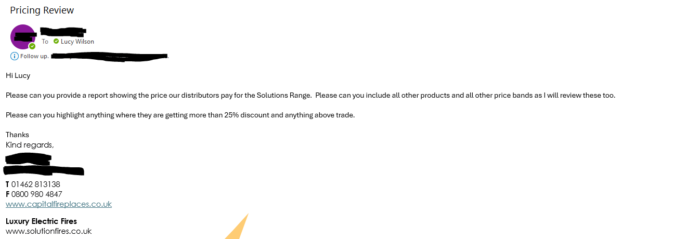
ASK - Problem or Question Statement
I was tasked with creating a document in an easily readable format for my MD to review the prices held on our system for each of our distributors. Specifically, our electric fire range but include all other products so he could review at the same time. He wanted to highlight anything of serious concern so anything more than 25% discount and anything above trade.
Duty 5 Support the organisation by maintaining and developing reports for analysis to aid with decisions, and adhering to organisational policy/legislation - K1 K2 K3 K7 K8 K10 K11 K12 S1 S2 S3 S5 S8 S9 S14 B1 B2 B3

Slide 6



PREPARE - Tools Used
I have used Excel for this task. Our Sage system easily exports data to excel so it is easier to manipulate from there
I have used outlook for communication
Duty 10 Provide regular reports and analysis to different management or leadership teams, ensuring data is used and represented ethically in line with relevant legislation (e.g. GDPR which incorporates Privacy by Design) - K1 K2 K3 K4 K5 K6 K7 K9 K10 K11 K12 K15 S1 S2 S4 S5 S7 S10 S12 S14 S15 B3 B4 B5

Slide 7
PREPARE - Legislation
I have adhered to the Data Protection Act 2018. There are no names or personal details show in the report
Duty 10 Provide regular reports and analysis to different management or leadership teams, ensuring data is used and represented ethically in line with relevant legislation (e.g. GDPR which incorporates Privacy by Design) - K1 K2 K3 K4 K5 K6 K7 K9 K10 K11 K12 K15 S1 S2 S4 S5 S7 S10 S12 S14 S15 B3 B4 B5
Duty 11 Ensure data is appropriately stored and archived, in line with relevant legislation e.g. GDPR - K1 K2 K3 K6 K8 K11 K12 S1 S2 S3 S9 B1 B3 B4

Slide 8
PREPARE - Data Identification
There are several ways of gathering the information needed from Sage. Pricebook holds all our pricing information for distributors but reports are limited and not many filters. There are some bespoke reports on the system that filter all products into categories so that would be a nice way to present the data but don’t have the pricing information on there so would need to combine data.
Duty 1 Identify data sources to meet the organisation's requirement, using evidence-based decision making to establish a rationale for inclusion and exclusion of various data sets and models - K1 K2 K3 K4 K5 K6 K8 K9 K10 K12 K15 S1 S2 S7 S8 S9 S15 B2 B3 B4 B5 B7
Duty 2 Liaise with the client and colleagues from other areas of the organisation to establish reporting needs and deliver insightful and accurate information - K1 K2 K3 K4 K5 K6 K9 K10 K11 K12 K15 S1 S2 S4 S5 S7 S12 B1 B3 B4 B5 B6 B7

Slide 9
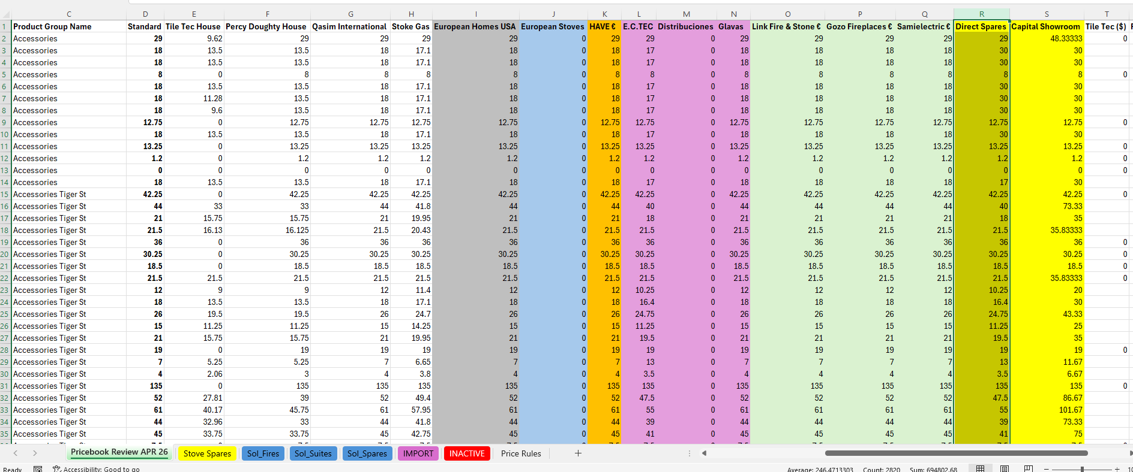
PREPARE - Data Collection
Firstly I gathered the information from a report that extracts all historical codes, all customer price bands and all prices in the relevant format for review, however it includes all inactive codes and you cannot filter the report. I cross referenced this with another report of inactive codes and used a VLOOKUP to see what was inactive on my report. Once complete I could still see codes that I knew to be inactive so the data source was wrong. I also ran into a problem when I initially worked on the file using local knowledge to try and filter out the codes manually soon realising this was going to take too long but I did not save the file because you cannot save as a CSV file when you add tabs and formatting etc so I have learned to save immediately as an Excel file.
Duty 3 Collect, compile and, if needed, cleanse data, such as sales figures, Digital Twins etc. solving any problems that arise, to or from a range of internal and external systems - K1 K2 K3 K4 K5 K6 K8 K10 K11 K12 K13 K15 S1 S2 S3 S4 S6 S7 S8 S9 S10 S13 B1 B2 B3 B4 B5 B6 B7

Slide 10
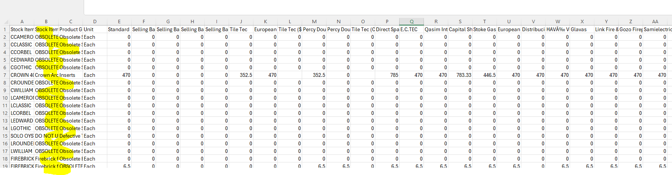
I sought advice from my colleague on this and we established that there is a problematic area in providing management information in the business in a consistent and comparable method from the system. Historical database configuration has lead to characters used in data fields clashing with computer commands and causing anomalies in data presentation. We fixed this by removing the characters and re running the report.
Below screenshot showing raw data with all inactive codes

Slide 11
I Established it was easier to combine a current stock report which is in a clear and readable format showing products in their groups separated and clearly laid out. I could then add the prices via VLOOKUP
I will still need to cleanse the data and move things around based on local knowledge. i.e I am given prices for a whole unit but on the system that unit is split into 2 parts so the parts need to appear together when the MD is reading it or the price will be incorrect.

Slide 12
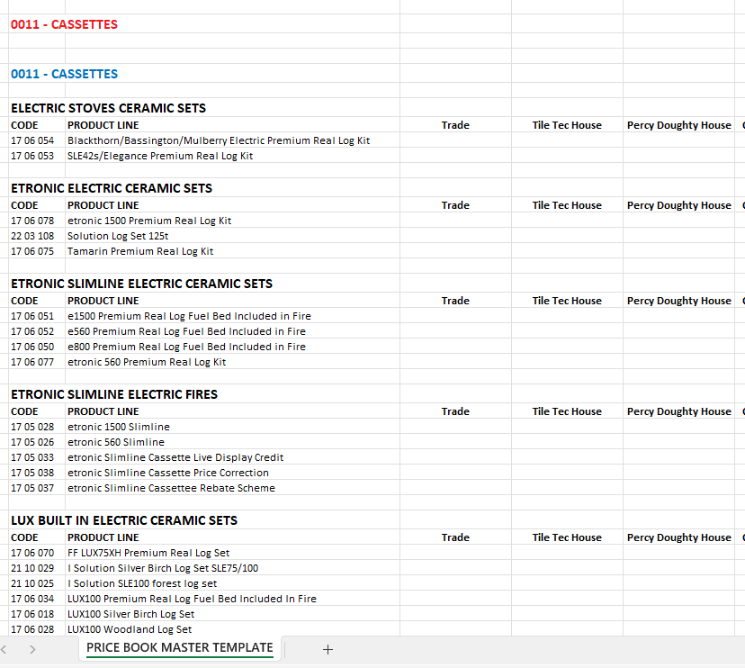
PROCESS - Data Cleansing, Standardisation or Normalisation
As per the brief I need to filter the electric range from all other goods I have separated into different tabs for the ranges of products to be reviewed. I have added columns for each distributor.
Duty 3 Collect, compile and, if needed, cleanse data, such as sales figures, Digital Twins etc. solving any problems that arise, to or from a range of internal and external systems - K1 K2 K3 K4 K5 K6 K8 K10 K11 K12 K13 K15 S1 S2 S3 S4 S6 S7 S8 S9 S10 S13 B1 B2 B3 B4 B5 B6 B7

Slide 13
ANALYSE – Statistical Analysis
Using a helper column in the Solution Fires sheet I was able to analyse how much of the total sheet was in need of serious review. Nearly 30% of all the prices were more than 25% discount and nearly 10% is above trade (Column Q and R don’t need review). I would recommend these prices are reviewed first. I can do the same analysis to the other products if required.
Duty 6 Produce a range of standard and nonstandard statistical and data analysis reports in the Model Building phase - K2 K3 K4 K5 K6 K7 K8 K9 K10 K11 K12 K13 K14 S1 S2 S3 S4 S5 S8 S9 S10 S11 S13 S14 B2 B3 B6 B7

Slide 14
ANALYSE - Data Visualisation
Used conditional formatting to highlight any prices above trade in orange = D2 > $C2
Used conditional formatting to highlight any prices more than 25% less than trade in pink =D2 , ($C2 * 0.75)
Duty 4 Produce performance dashboards and reports in the Visualisation and Model Building Phase - K1 K2 K3 K4 K5 K6 K7 K8 K9 K10 K11 K12 K13 K15 S1 S2 S3 S4 S5 S7 S8 S9 S10 S11 S12 S13 S14 S15 B2 B3 B4

Slide 15
ANALYSE - Data Analysis
The pricing file is extensive and requires meticulous review. I have highlighted areas of concern. Anything orange above trade that isn't in column Q and R is a major concern as no one should pay above trade for any item. Q and R are direct sales and they do pay more than our retailers so that’s fine. Anything highlighted in purple is more than 25% off trade this is an area of concern as even our largest distributors tend to only get 25% off. Either the price is wrong or we expect the customer to buy in large quantities. There are rather a lot of purple and not in any kind of pattern pointing towards an error in pricing. You expect to see purple for the import bands as they only have prices set up for set products so trade would show £0. Some distributors look like they generally receive the same pricing structure however they are not in the same band and just a few items are different but not by much. I have suggested for ease of importing customer pricing that these customers are placed withing one band say European Distribution Tier 1 instead of different bands for each customer.
Duty 7 Identify, analyse, and interpret trends or patterns in data sets - K1 K2 K3 K4 K5 K8 K10 K11 K12 K13 K14 K15 S1 S2 S3 S4 S5 S6 S10 S11 S13 S14 B2 B3 B4 B5 B7

Slide 16
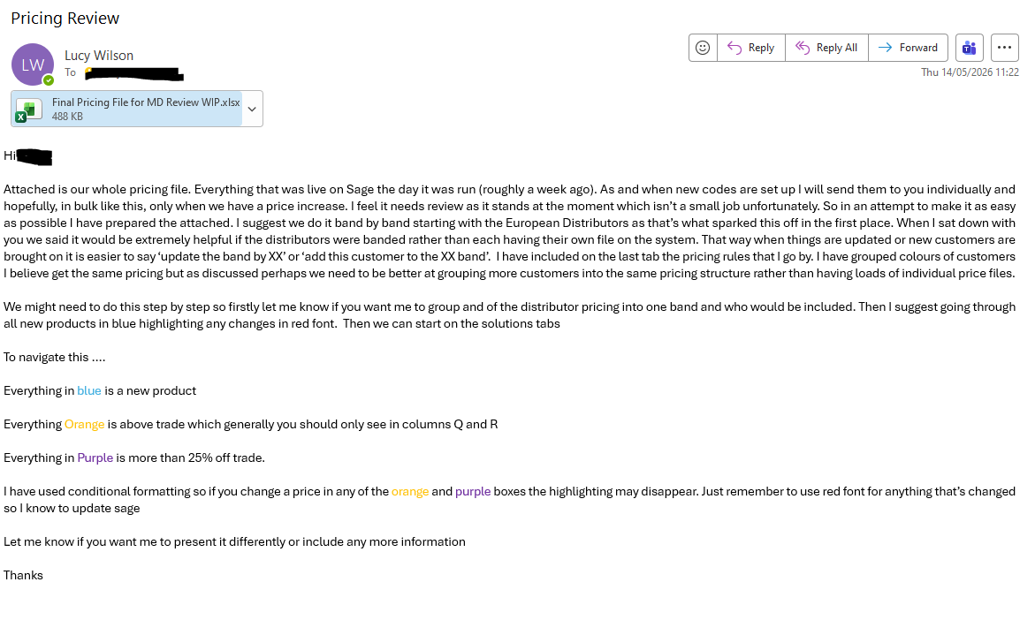
SHARE - My Recommendation
Duty 8 Draw conclusions and recommend an appropriate response, offer guidance or interpretation to aid understanding of the data - K1 K2 K7 K8 K11 K14 S1 S2 S3 S4 S5 S7 S10 S11 S12 S13 S14 B2 B3 B4 B5 B7

Slide 17
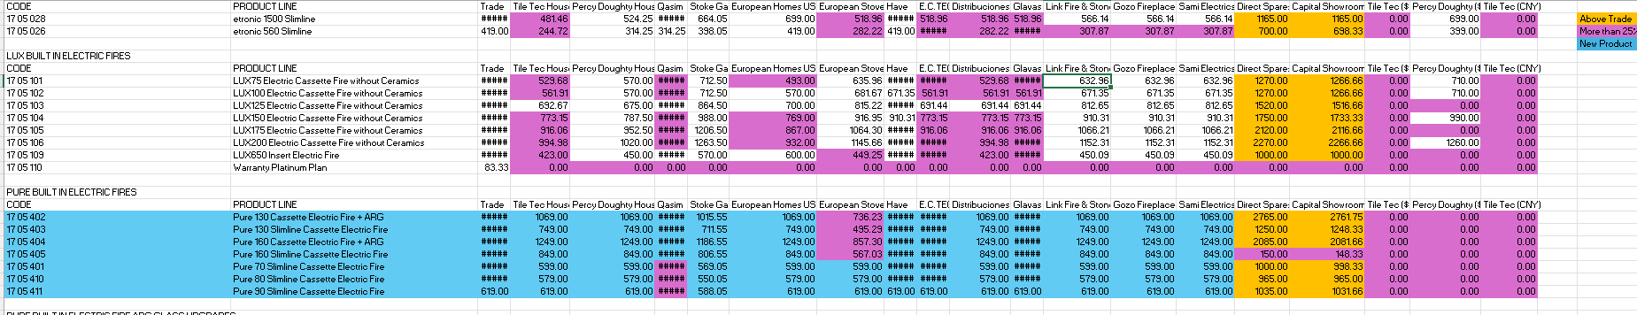
SHARE - My Presentation
Duty 9 Summarise and present the results of data analysis to a range of stakeholders, making recommendations - K2 K3 K4 K5 K7 K9 K10 K12 K13 K15 S1 S2 S4 S5 S7 S9 S12 S14 S15 B1 B3 B4 B7

Slide 18
ACT – Next Steps
It is clear that having a price band per customer is complicated and messy. I have suggested having a tiered system and my MD has agreed to this. He will review what customers need to be added to what band and will confirm the pricing structure going forward. This will speed up information going both ways. I can provide information to him when he was to review anything and he can give it back to me in a format that is easy to import to the system. On top of this we have been in contact with Sage to try and get an easier export function so we can sort by analysis fields we have created on the system. This will allow us to run and review only codes from certain groups, certain suppliers and certain brochures and so on. It will show only active codes too.
Duty 5 Support the organisation by maintaining and developing reports for analysis to aid with decisions, and adhering to organisational policy/legislation - K1 K2 K3 K7 K8 K10 K11 K12 S1 S2 S3 S5 S8 S9 S14 B1 B2 B3

Slide 19
My Reflection
What went well? What will you change next time? Did you learn anything while completing this work project?
I feel the whole project went well. I made sure to discuss with other colleagues along the way about the best ways of doing it before I went to far in the wrong direction. My initial report was just one long list of products whereas the second report was grouped into product types and families making it easier for the reader to review pricing. I learned I could combine these two reports by using VLOOKUP and adding all the price bands into a better report with current active codes. I enhanced this by using conditional formatting to highlight areas of concern. Next time I will start with the better report and add in the bands. It was good to be able to provide the information required in a clear readable format. It would be good to use this report going forward for smaller groups of products or one specific price band which I can do one the main review is complete. Up until now once the price goes into the system no review has taken place because there has been no way to extract the information in a clear way without including loads of inactive products. This will help the company going forward.
Duty 12 Practice continuous self-learning to keep up to date with technological developments to enhance relevant skills and take responsibility for own professional development - K7 K8 K10 K11 K13 K14 K15 S1 S3 S4 S6 S7 S12 B1 B2 B3 B4 B5 B6 B7

